Slide 1
Data Structure and Algorithm CSE-225
Dr. Mohammad Abu Yousuf
yousuf@juniv.edu

Slide 2
Linked list

Slide 3
Linked list
A linked-list is a sequence of data structures which are connected together via links.
Linked List is a sequence of links which contains items. Each link contains a connection to another link. Linked list the second most used data structure after array. Following are important terms to understand the concepts of Linked List.
Link − Each Link of a linked list can store a data called an element.
Next − Each Link of a linked list contain a link to next link called Next.
LinkedList − A LinkedList contains the connection link to the first Link called First.

Slide 4
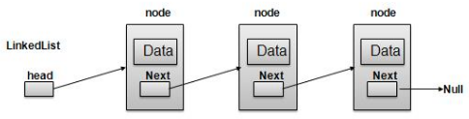

Linked List Representation
As per above shown illustration, following are the important points to be considered.
Linked List contains an link element called first.
Each Link carries a data field(s) and a Link Field called next.
Each Link is linked with its next link using its next link.
Last Link carries a Link as null to mark the end of the list.

Slide 5
Types of Linked List
Following are the various types of linked list.
Simple Linked List − Item Navigation is forward only.
Doubly Linked List − Items can be navigated forward and backward way.
Circular Linked List − Last item contains link of the first element as next and first element has link to last element as prev.

Slide 6
Simple Linked List : Basic Operations
Following are the basic operations supported by a list:
Insertion − add an element at the beginning of the list.
Deletion − delete an element at the beginning of the list.
Traverse − Traversing complete list.
Search − search an element using given key.
Delete − delete an element using given key.

Slide 7
Simple Linked List : Basic Operations
Traversing a Linked List:
Suppose we want to traverse LIST in order to process each node exactly once.
The traversing algorithm uses a pointer variable PTR which points to the node that is currently being processed. Accordingly, PTR->NEXT points to the next node to be processed

Slide 8
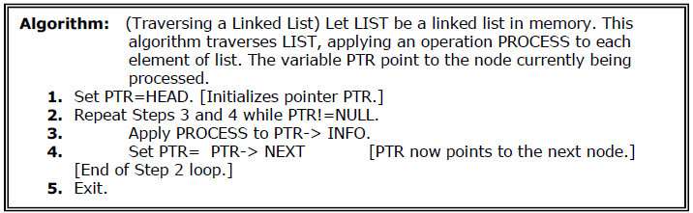
Simple Linked List : Basic Operations
Traversing a Linked List:

Slide 9
Simple Linked List : Basic Operations
Searching a Linked List:
Let list be a linked list in the memory and a specific ITEM of information is given to search.
Search for wanted ITEM in List can be performed by traversing the list using a pointer variable PTR and comparing ITEM with the contents PTR->INFO of each node, one by one of list.

Slide 10
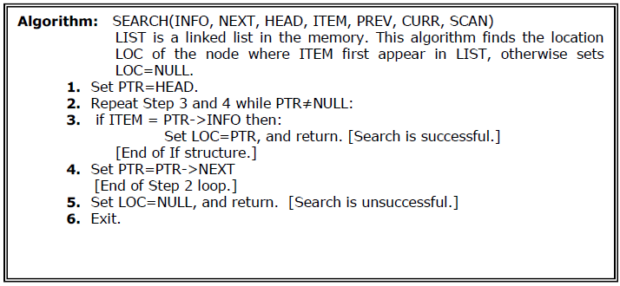
Simple Linked List : Basic Operations
Searching a Linked List:

Slide 11
Simple Linked List : Basic Operations (Insertion)
To add a new node, we must identify the logical predecessor (address of previous node) where the new node is to be inserting.
There are three situation for inserting element in list.
Insertion at the front of list.
Insertion in the middle of the list.
Insertion at the end of the list.

Slide 12
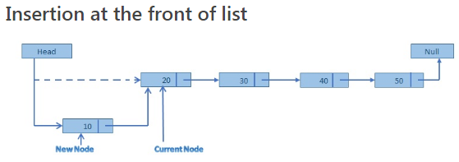
Simple Linked List : Basic Operations (Insertion)

Slide 13
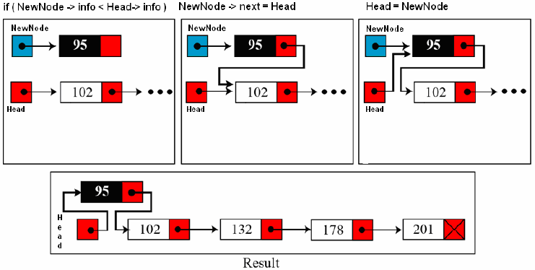
Inserting at the Beginning of a List:
If the linked list is sorted list and new node has the least low value already stored in the list i.e. (if New->info < Head->info) then new node is inserted at the beginning / Top of the list.

Slide 14
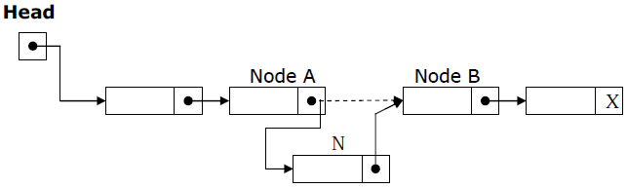
Simple Linked List : Basic Operations (Insertion)
If a node N is to be inserted into the list between nodes A and B in a linked list named LIST. Its schematic diagram would be;

Slide 15
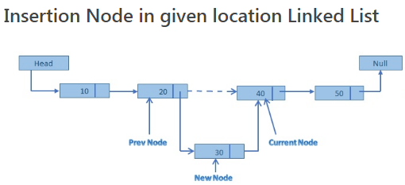
Simple Linked List : Basic Operations (Insertion)

Slide 16
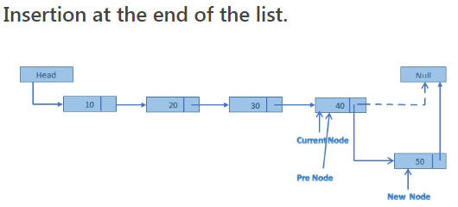
Simple Linked List : Basic Operations (Insertion)

Slide 17
Simple Linked List : Basic Operations
Insertion is a three step process −
Create a new Link with provided data.
Point New Link to old First Link.
Point First Link to this New Link.

Slide 18
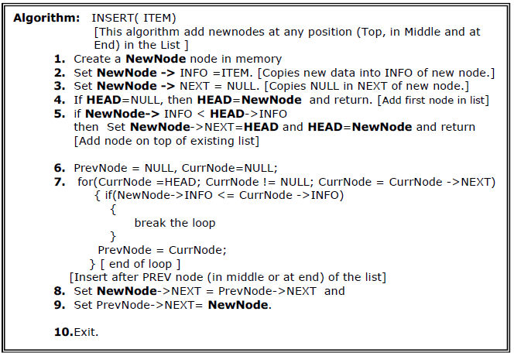
Simple Linked List : Basic Operations

Slide 19
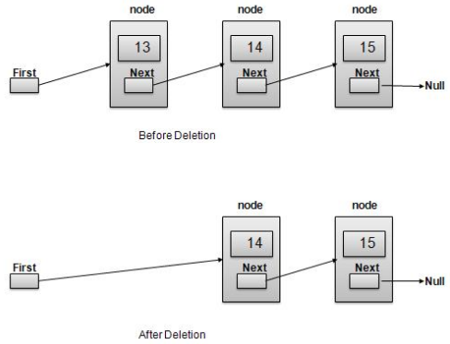
Simple Linked List : Basic Operations
Deletion Operation: Deletion is a two step process −
Get the Link pointed by First Link as Temp Link.
Point First Link to Temp Link's Next Link.

Slide 20
Simple Linked List : Basic Operations
Deleting a node from a linked list is straightforward but there are a few cases we need to account for:
1. the list is empty; or
2. the node to remove is the only node in the linked list; or
3. we are removing the head node; or
4. we are removing the tail node; or
5. the node to remove is somewhere in between the head and tail; or
6. the item to remove doesn't exist in the linked list

Slide 21
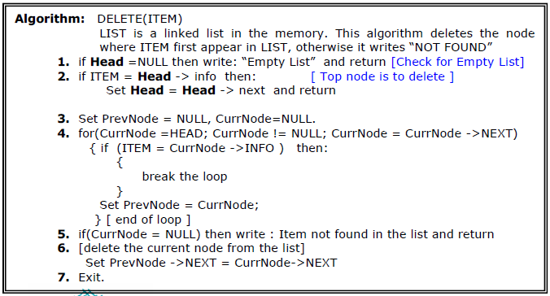
Simple Linked List : Basic Operations
The following algorithm deletes a node from any position in the LIST.

Slide 22
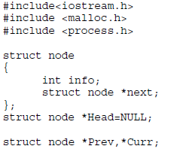
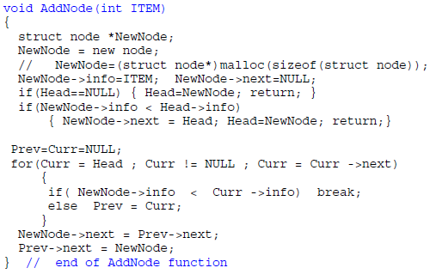
A Program that exercise the operations on Liked List

Slide 23
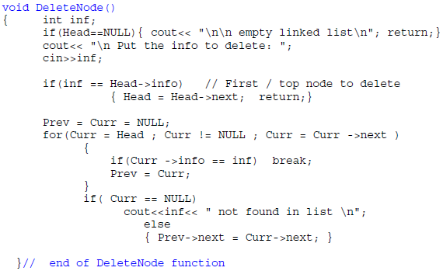

Slide 24
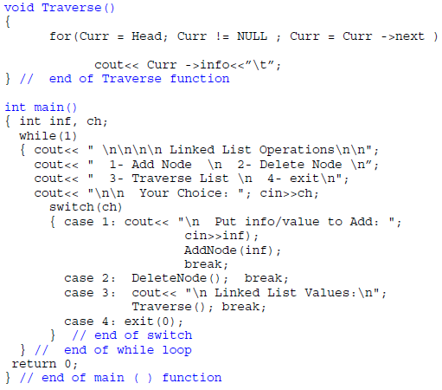

Slide 25
Insertion In Circular Linked List
There are three situation for inserting element in Circular linked list.
1.Insertion at the front of Circular linked list. 2.Insertion in the middle of the Circular linked list. 3.Insertion at the end of the Circular linked list.

Slide 26
Insertion In Circular Linked List
Insertion at the front of Circular linked list :
Step1. Create the new node
Step2. Set the new node’s next to itself (circular!)
Step3. If the list is empty, return new node.
Step4. Set our new node’s next to the front.
Step5. Set tail’s next to our new node.
Step6. Return the end of the list.

Slide 27
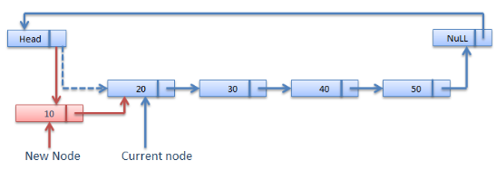
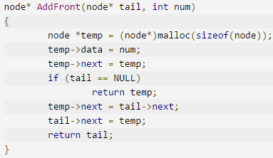

Slide 28
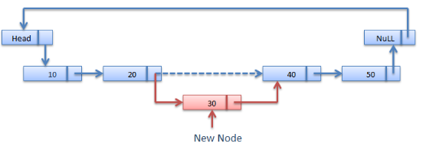
Insertion in the middle of the Circular linked list:

Slide 29
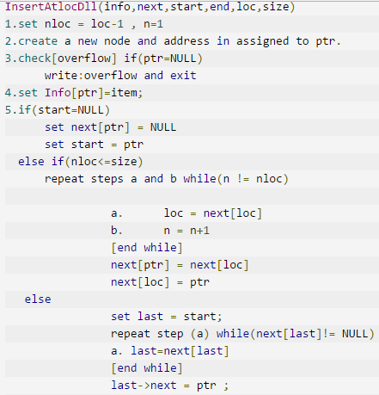
Insertion in the middle of the Circular linked list:

Slide 30
Insertion at the end of Circular linked list :
Step1. Create the new node
Step2. Set the new node’s next to itself (circular!)
Step3. If the list is empty, return new node.
Step4. Set our new node’s next to the front.
Step5. Set tail’s next to our new node.
Step6. Return the end of the list.

Slide 31
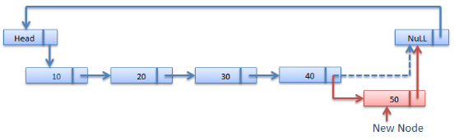
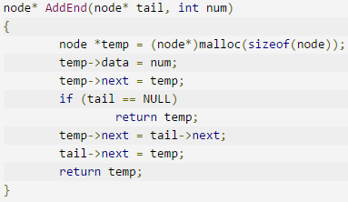

Slide 32
Thank you

